Slide 1
NURSE BAND 5
REVIEW PROCESS

Slide 2
Key information from national guidance
Band 5 nurses only
Individual applications
Can work collectively
Based on 75 questions answered within the portal
Must be approved by line manager/service manager and senior nurse for submission
Effective date 1.4.23 or start date in post if later
Includes bank staff – link in bank only workers who regular work in your area
No closing date at present

Slide 3
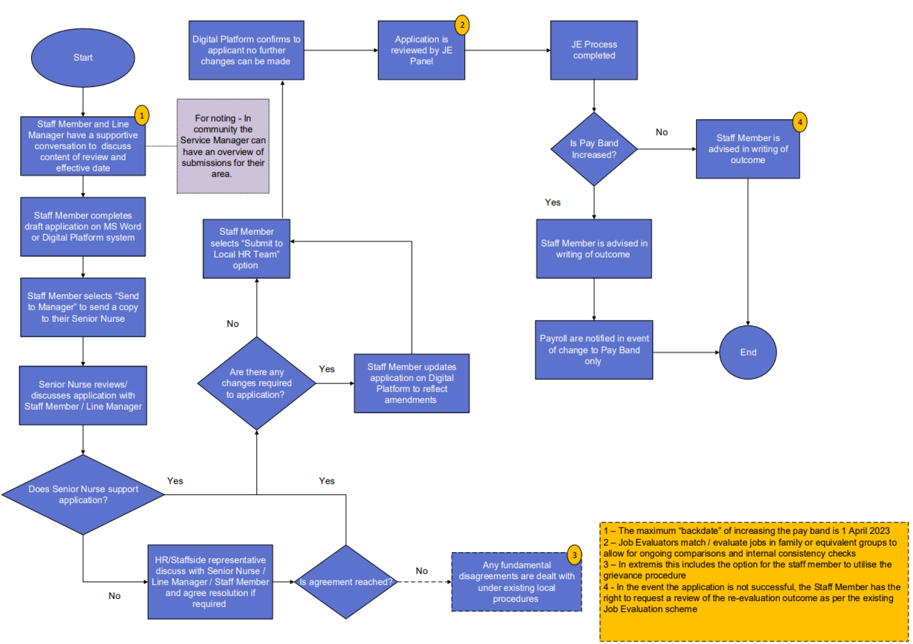

Slide 4
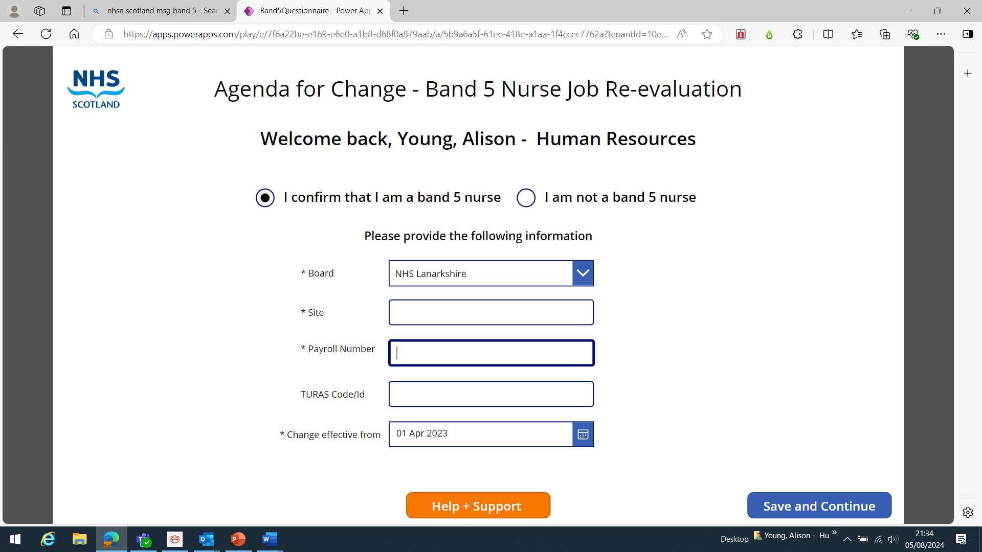
Payroll number is needed – find this on your payslip
Turas code is the code used in job evaluation (not mandatory)

Slide 5
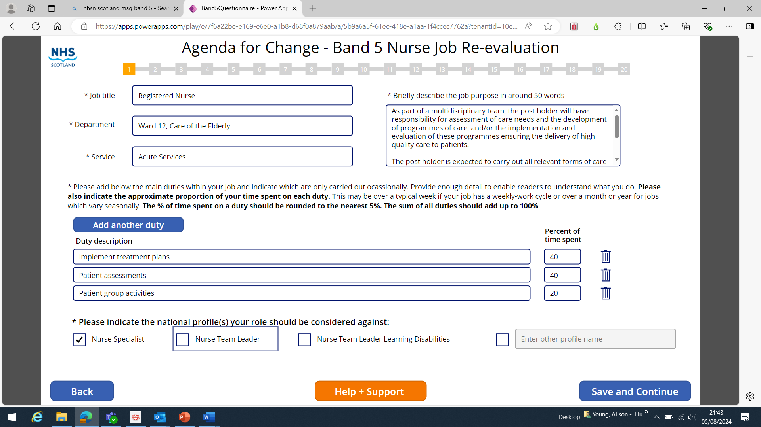
Link - National job profiles | NHS Employers

Slide 6
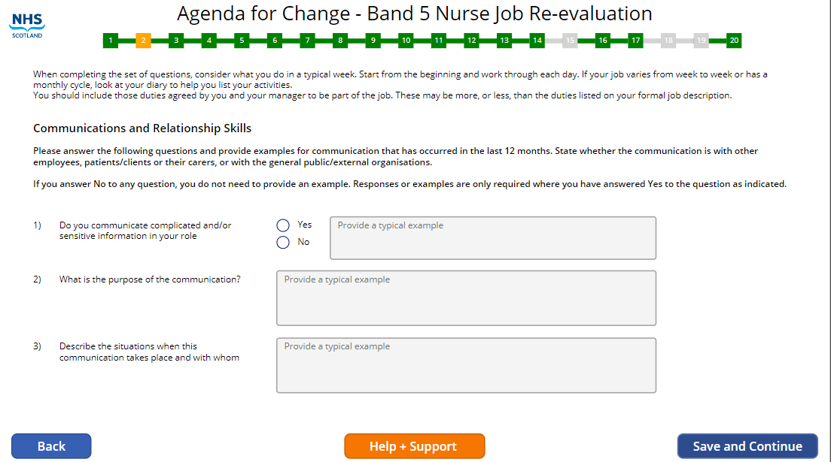

Slide 7
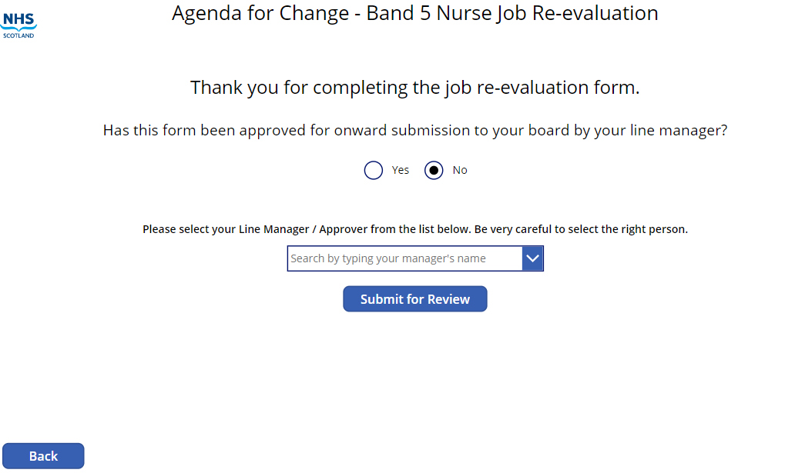
Make sure you know the name of the manager (Senior Nurse) who will approve the application and their email address
Use this format to search for your manager Last Name comma First Name (e.g. Bevan, Audrey)

Slide 8
ACTIONS – for Nurses
Read the circular
Download the questionnaire
Read the guidance
Read the FAQs
Find out where you can get advice and support e.g. your manager, staffside representative, HR Website
Get a copy of your job description from your personal file

Slide 9
ACTIONS for Nurses
Meet with your Team Leader / Senior Charge Nurse
1
Start gathering the information you might need for your application
2
Be clear about what you need to do – this is your individual application
3

Slide 10
Agenda for Change Review website
https://www.stac.scot.nhs.uk/agenda-for-change-pay-and-reform
Review of band 5 nursing roles - Circular
Online digital application portal link
Word version of the application questionnaire (can be downloaded – advice is to complete this first and have agreed) Review-of-Band-5-Nursing-Roles-Questionnaire.docx (live.com)
Guidance on completing an application Glossary / Frequently Asked Questions Flow Chart showing the process (be mindful of local arrangements as discussed today)

Slide 11

Reference Points
Access portal here - https://www.stac.scot.nhs.uk/agenda-for-change-pay-and-reform
Review-of-Band-5-Nursing-Roles-Questionnaire.docx (live.com)
Review-of-Band-5-Nursing-Roles-Guidance-Documentation.pdf (scot.nhs.uk)
Nurse Band 5 Application Questionnaire Guidance - Main tasks amend 18092024.doc
Review-of-Band-5-Nursing-Roles-Frequently-Asked-Questions-1.pdf (scot.nhs.uk)
National job profiles | NHS Employers
HR Service Now – Firstport / Applications / HR Service Now / Workforce / Workforce Solutions / Job Evaluation
MS Teams Channel Band 5 Nurses - https://msteams.link/0K0N

