Slide 1
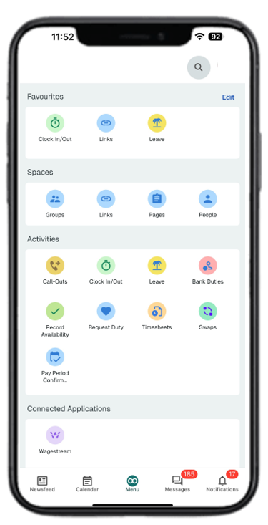
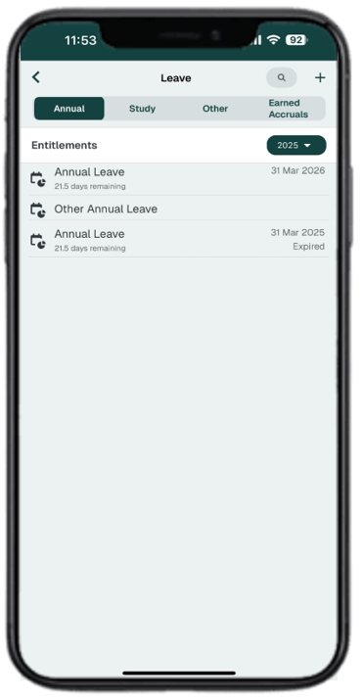
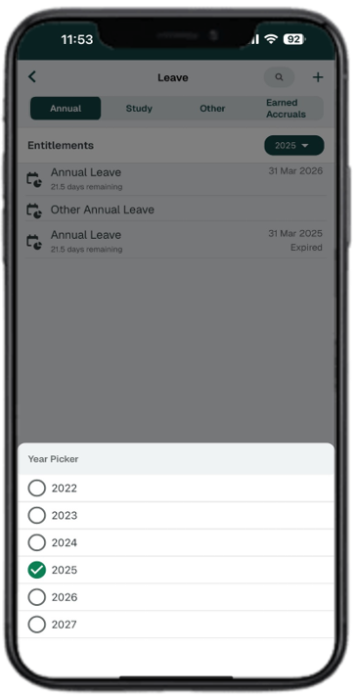

Loop – Request Leave
1
Select the Loop Logo at the bottom of the screen and then select Leave
2
You can view your Annual, Study and Other leave by selecting the links at the top of the screen
3
Select the Year in the top right to change the year you would like to view/request leave.
4
Select the Leave Entitlement to view the dashboard and balance

Slide 2
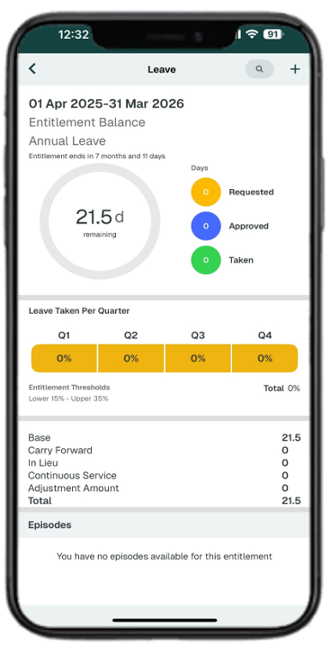
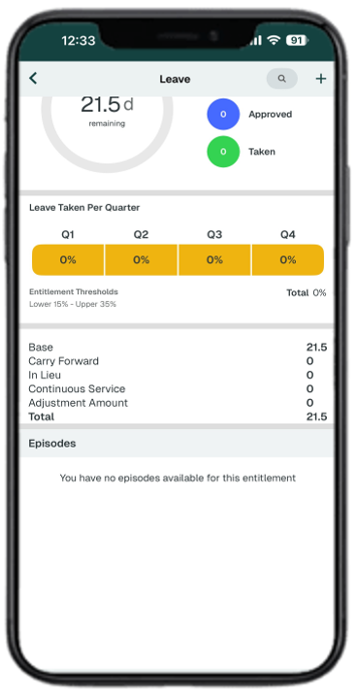
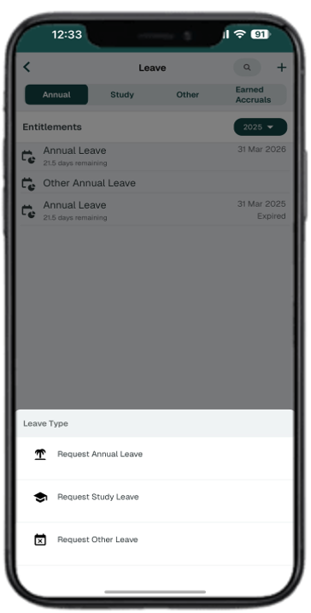
Loop – Request Leave
5
The dashboard shows a summary of Leave Entitlement
6
Scroll down to view more information and Approved Leave
7
Select the + in the top right to add a Leave Request
8
Select the type of leave you would like to request

Slide 3
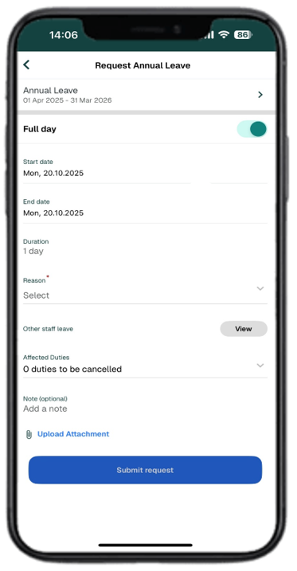
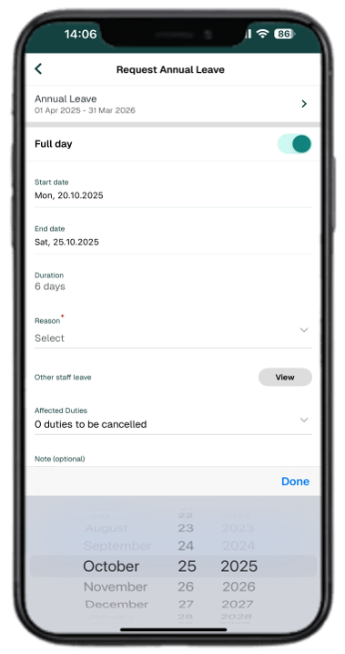
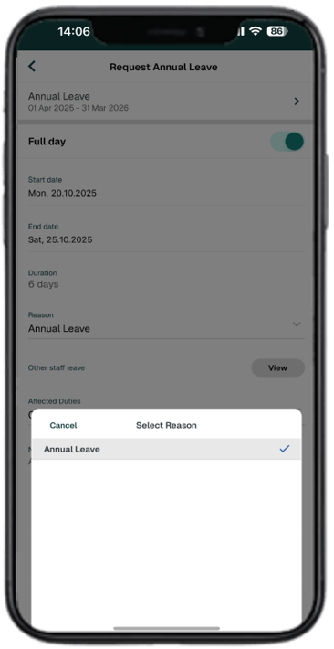
Loop – Request Leave
9
Select the Start date to change the date.
10
Select the date and select Done. Repeat for the End date. Swipe the Full day to Off if a full day’s leave is not required
11
Select Reason
12
Select from the available list.

Slide 4
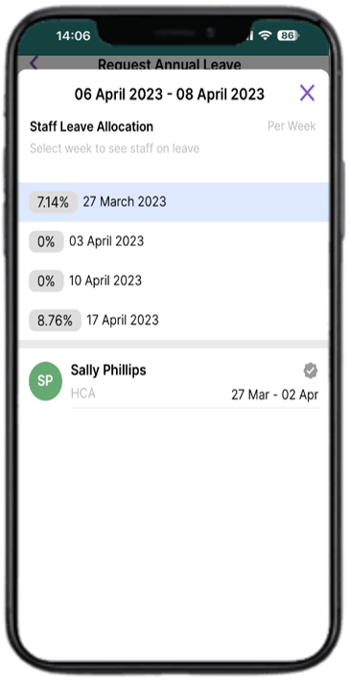
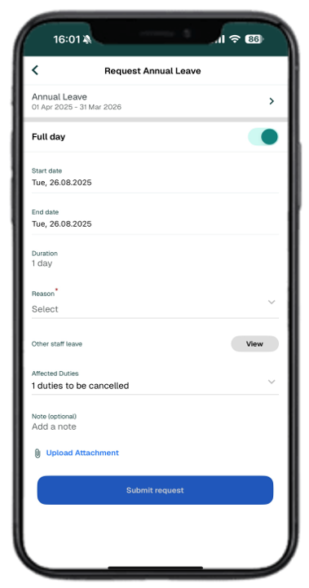
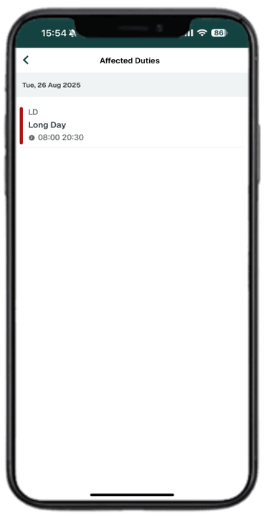
Loop – Request Leave
13
To view other staff leave, select the View button.
14
Select the X to close
15
To view the Affected Duties, select Affected Duties at the bottom of the screen
16
Select the arrow head in the top left to go back.

Slide 5
Loop – Request Leave
17
There is an optional Note field to add any notes.
When you have completed the form, select Submit request

